Slide 1
ENERGY RESOURCEFUL BLUETOOTH SWAPPING IN ANDROID DEVICES
PRESENTED BY
S.SURIYAN
GUIDED BY
Dr.R.U.Anitha., MCA., M.Phil., Ph.D

Slide 2
ABSTRACT
Bluetooth has transformed itself from a cable replacement technology to a wireless technology that connects people and machines.
In this process we propose a noble system to reduce the power that is wasted during the practice of Bluetooth in a well proficient style.
Here we propose a system to communicate between two android devices independently without any intermediate.

Slide 3
EXISTING SYSTEM
The existing system has a lot of drawbacks like more power usage while Bluetooth is in use.
Data delivery from one device to another device requires intermediate to transfer the data packets.
The existing system tools show less efficiency in data packet delivery due to intermediate interference.

Slide 4
PROPOSED SYSTEM
The project is to develop an android application for data transfer in a network without any intermediate interference.
The devices between the ranges can communicate with the help of the developed android application.
The power consumption due to the use of the application is reduces efficiently to make the application more effective.

Slide 5
MODULES
Let See the Number of modules.

Slide 6
NUMBER OF MODULES
Device Scanning
Device Authentication
Secure Transmitting
Connection Rescheduling
Energy reduction intended for Bluetooth convention

Slide 7
MODULES DESCRIPTION
Let See the Description of modules.

Slide 8
DEVICE SCANNING
Application is intended to scan or sensor devices that are near by or reachable to the range of Bluetooth from the mobile device.
The devices are scanned with less energy consumption from the device to increase power efficiency during the processing of the system.
Once the sensing is completed the device lists all the devices that are available to communicate. Thus allowing us to select a device to communicate.

Slide 9
DEVICE AUTHENTICATION
The devices that are available are listed the device is chosen to communicate.
Once the device is chosen an authentication request is sent to the native device to accept the connection.
This is done internally to reduce complexity to the user who used the application.
The authentication is accepted by the native device and then only the communication connection is made between the two device

Slide 10
SECURE TRANSMITTING
The destination node is chosen from the device the packet that re required to be sent to the destination is made ready.
And later the packets are sent in the Bluetooth network that is established between the two devices.
The packets that are send is directly delivered to the destination without using any intermediate for communication.

Slide 11
CONNECTION RESCHEDULING
The packets are received. Once the packets are sending from the source the packets travel through the Bluetooth network and reach the destination device.
The packets are received by the device and are processed. After processing the request the previous module is continued here to deliver packets from here to the source device.
Again the same process is repeated to deliver the packets.

Slide 12
ENERGY REDUCTION INTENDED FOR BLUETOOTH CONVENTION
The data communication between the devices is achieved using Bluetooth.
And the connection is peer to peer connection.
This is done by reducing the monitoring time of devices in the network often.
Here the monitoring is reduced and when ever needed it is implemented. Thus it helps in reducing the power consumption. Thus the system is made energy efficient.

Slide 13
DATA FLOW DIAGRAM
Let See the DFD here .

Slide 14
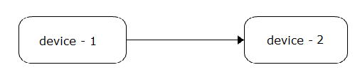
DATA FLOW DIAGRAM LEVEL-1

Slide 15
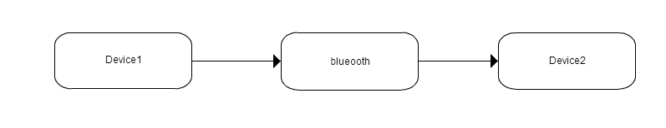
DATA FLOW DIAGRAM LEVEL-2

Slide 16
SYSTEM ARCHITECTURE
Let See the Architecture here .

Slide 17
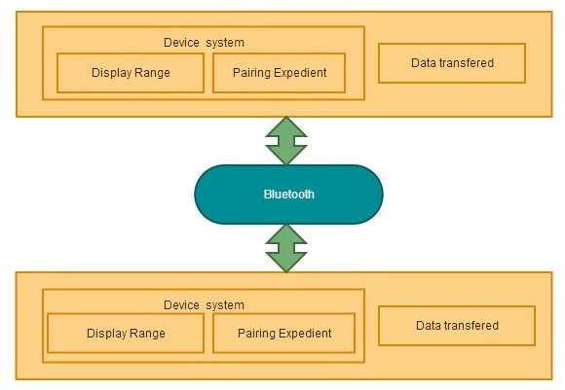
SYSTEM ARCHITECTURE

Slide 18
SCREENSHOTS
Let See the Tested Screenshots here .

Slide 19
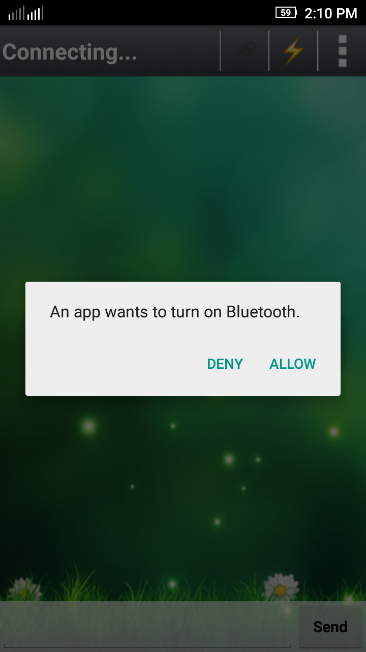
TURN ON BLUETOOTH
It is the Initial Step while open the app.

Slide 20
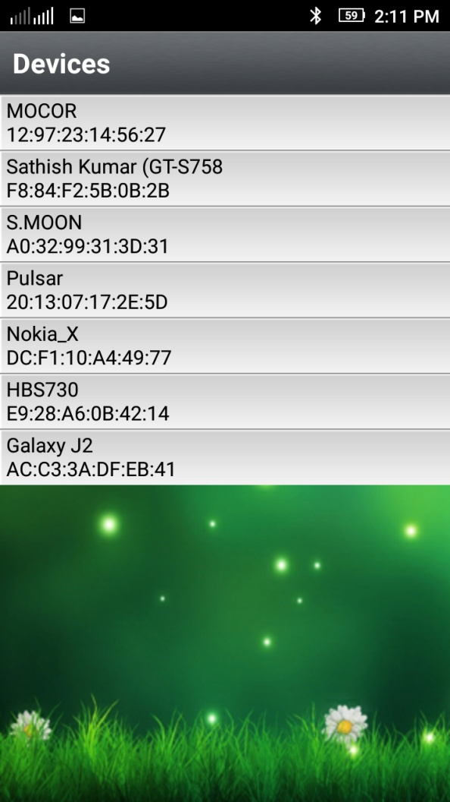
NEARBY DEVICES
Select name of the device to made a connection.

Slide 21
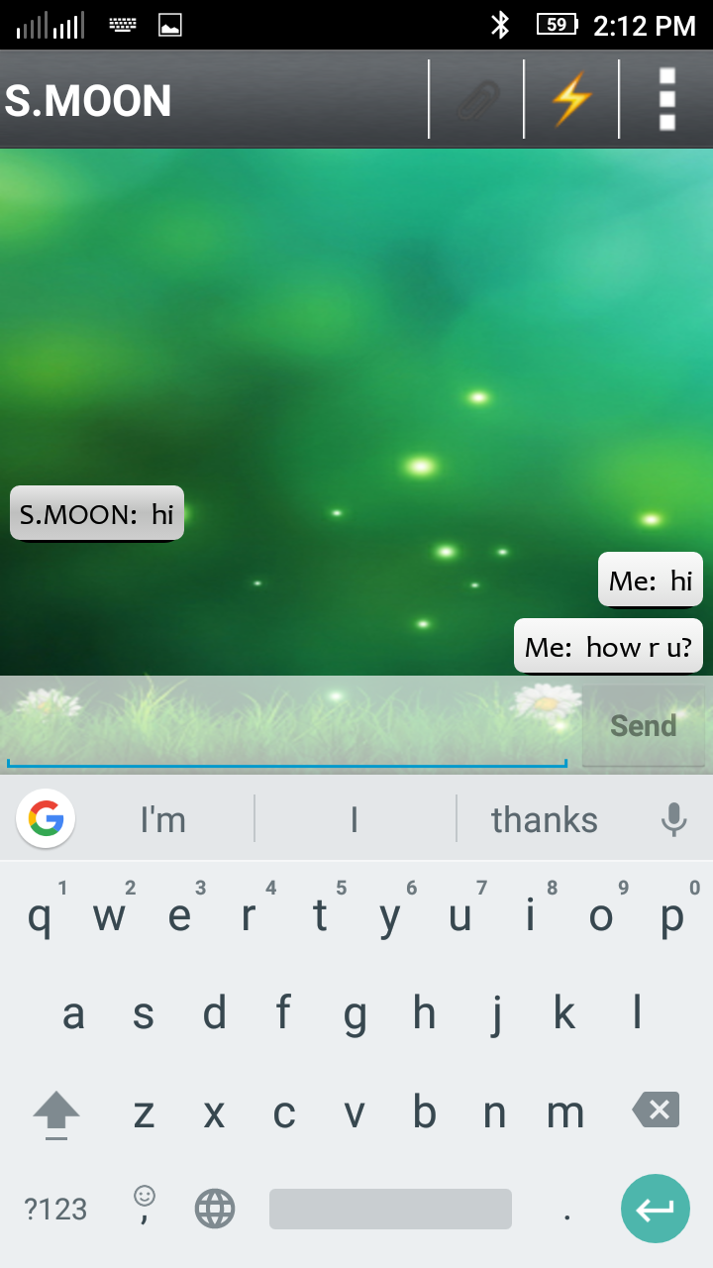
INSTANT CHAT
Chat instantly with destination device via Bluetooth.

Slide 22
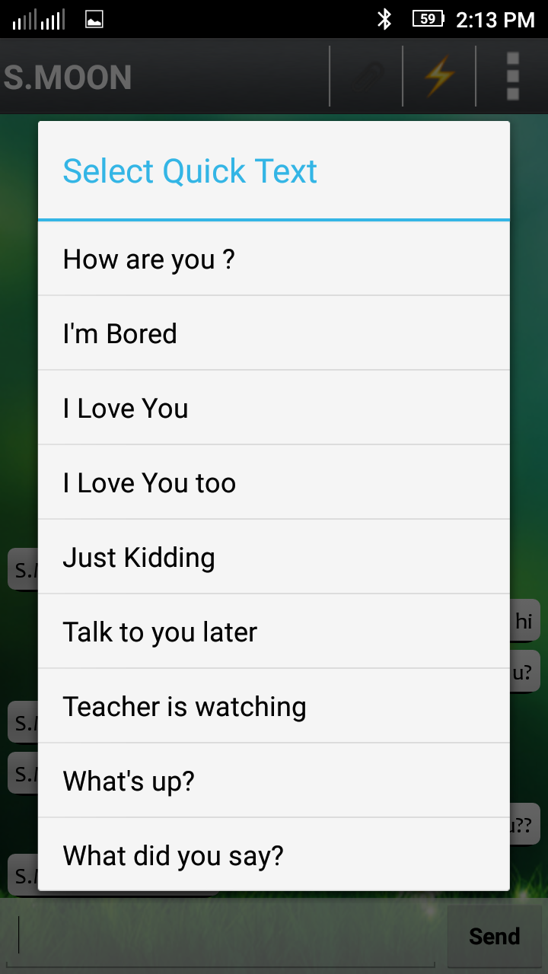
QUICK TEXT
Quick text helps to send templates.

Slide 23

CHAT THEME
You can also change your chat theme here

Slide 24
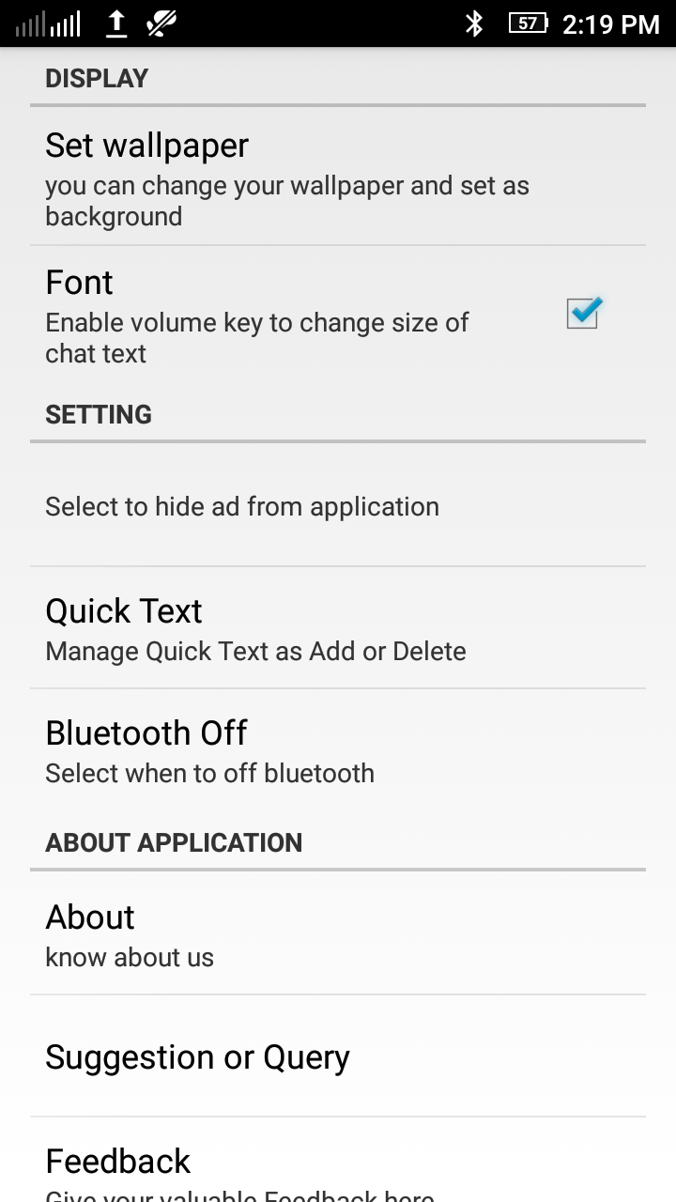
SETTINGS
Several options to change your settings .

Slide 25
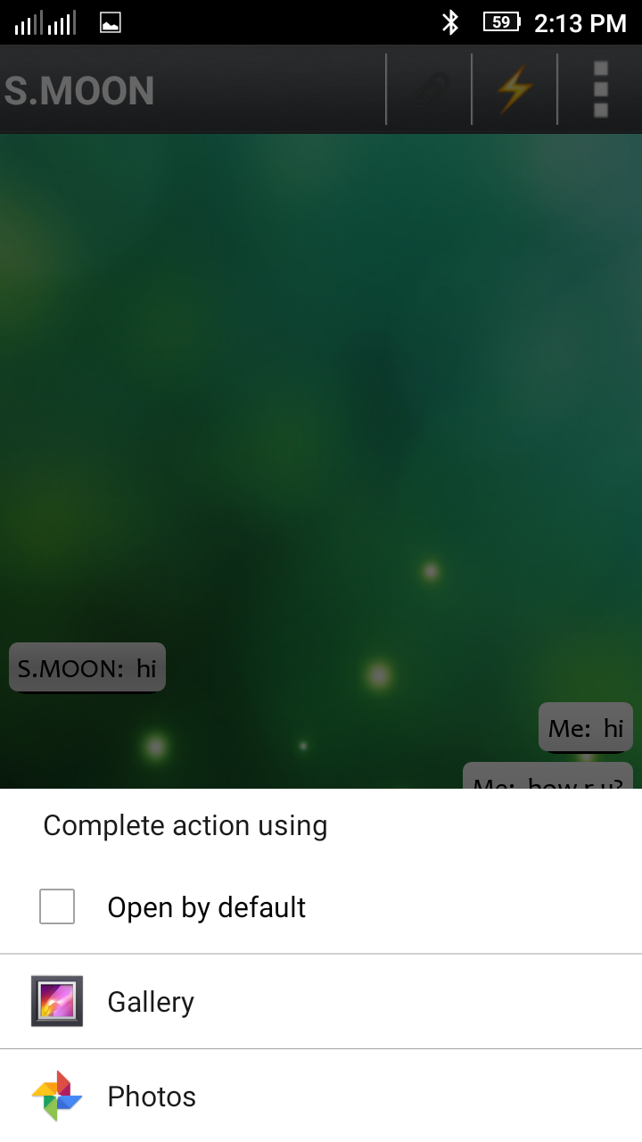
PHOTO SHARE
Instantly you can Share photos here.

Slide 26
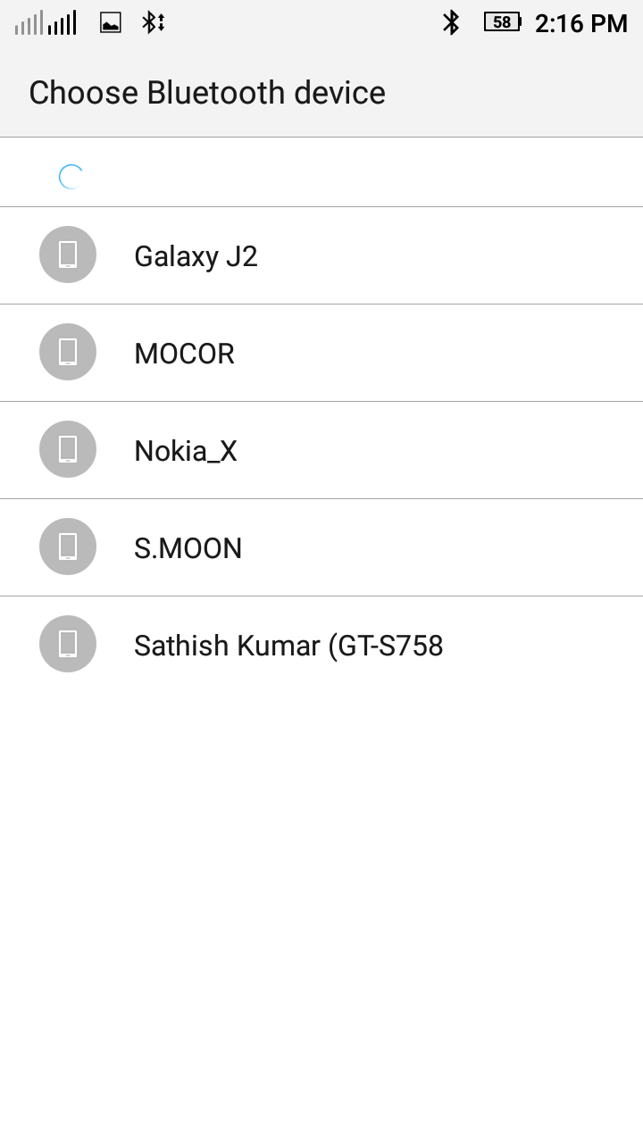
DEVICE TO SHARE
Choose your destination device to share photos.

Slide 27
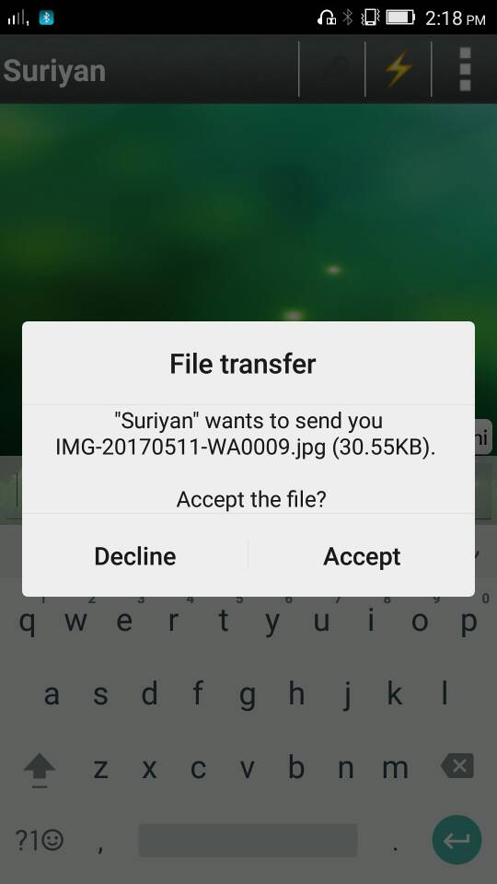
CONFIRMATION TO RECEIVE THE FILE
Your destination should accept your file transfer request.

Slide 28
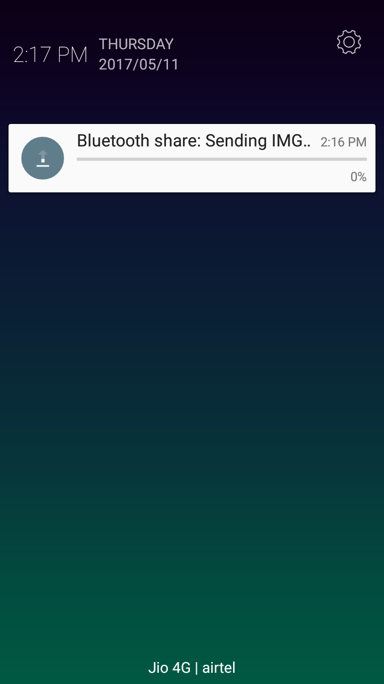
File Transferring
Selected File is sharing here

Slide 29
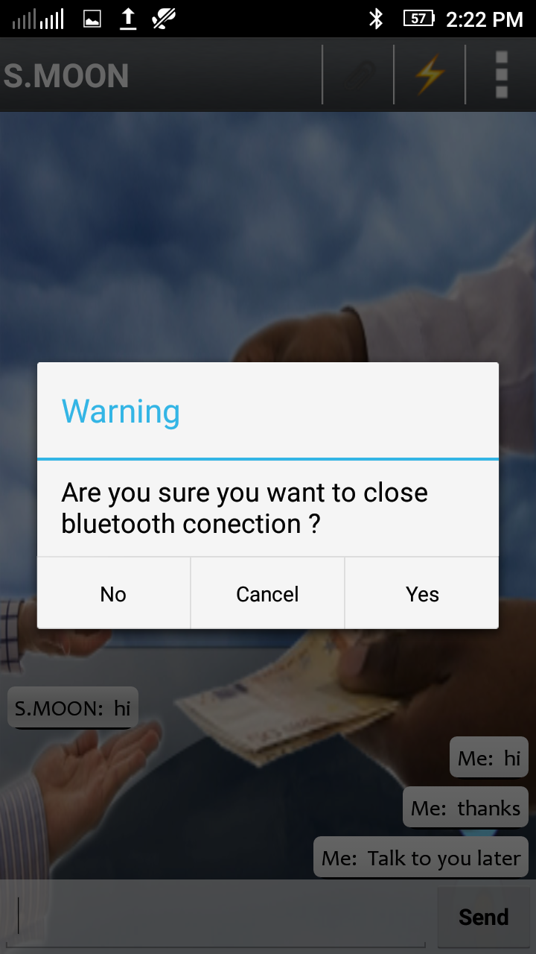
WARNING BEFORE CLOSING BLUETOOTH
Warning prompt to close your Bluetooth Connection

Slide 30
CONCLUSION
All the problems in the existing system where analyzed and has overcome in the proposed system as well.
The project is designed in a user friendly way. All the requirements are met and fulfilled.
The project shows well reliable data transfer rate.
The data’s are transferred and maintained in secure manner.
The project shows reliable data transfer and also show reliable power consumption.

Slide 31
FUTURE ENHANCEMENTS
Enhancing security by encryption.
Improving the range of Bluetooth.
Improving the speed of communication.
Extending the Frequency Band.

Slide 32
THANK YOU
Any questions?

